Slide 1

EASY ELECTRONICS
(E-Commerce for Online Electronics shopping )
Group No.3
Hrithik Patil 11
Leander Pereira 16
Rahul Pereira 17
Date of presentation:26th November 2020
Under the guidance of: Purnima Kubde
St. Francis Institute of Technology
Department of Information Technology

Slide 2

Content
Introduction
Objective and scope of project
Problem definition & Proposed solution
Comparative study of Existing systems
Hardware & Software requirements
User Interface Design
Results and Discussions
Conclusions
Future Scope
Literature Cited (book, web & paper References)

Slide 3
Introduction
E-COMMERCE:
Ecommerce, also known as electronic commerce.
Internet commerce, refers to the buying and selling of goods or services using the internet, and the transfer of money and data to execute these transactions.
Ecommerce is often used to refer to the sale of physical products online, but it can also describe any kind of commercial transaction that is facilitated through the internet.

Slide 4
Objective and Scope of project
Easy returns in case of customers dissatisfaction.
Providing customer care service 24/7.
Customers are able to choose and compare from the variety of products easily without wasting their time and efforts.
Providing convenient way of shopping.
Providing 100% satisfaction to the customers for the goods purchased.
Easy return of products purchased.

Slide 5
Problem definition & Proposed solution
Problem definition:
The customer’s have very less options to choose from.
No ratings provided of new products.
Bad or no customer service.
Proposed solution:
We created online electronics website where customers can shop the products online which will be delivered to them at the specified address.
Our website will have a wide range of products for the customer to choose from with easy returns and 24hr customer care support.

Slide 6
Comparative study of Existing systems
Sr. No. | Features | Amazon | Flipkart | Croma | Your website
1 | Registration form | Yes | Yes | Yes | Yes
2 | Geolocation | Yes | No | yes | No
3 | Product details | No | Yes | Yes | Yes
4 | Images of products | Yes | Yes | Yes | Yes
5 | Contact Us | Yes | No | No | Yes

Slide 7
Hardware & software requirements
1. Software requirements –
Operating System - WINDOWS 10
Brackets
Web Browser - google chrome
2. Hardware requirements –
RAM - 4GB and above
Intel processor - i3 and above
CPU - 1.60GHz and above
Internet connection

Slide 8
Skeleton of website
HOME
LOG IN
ABOUT US
FAQ
CONTACT US

Slide 9
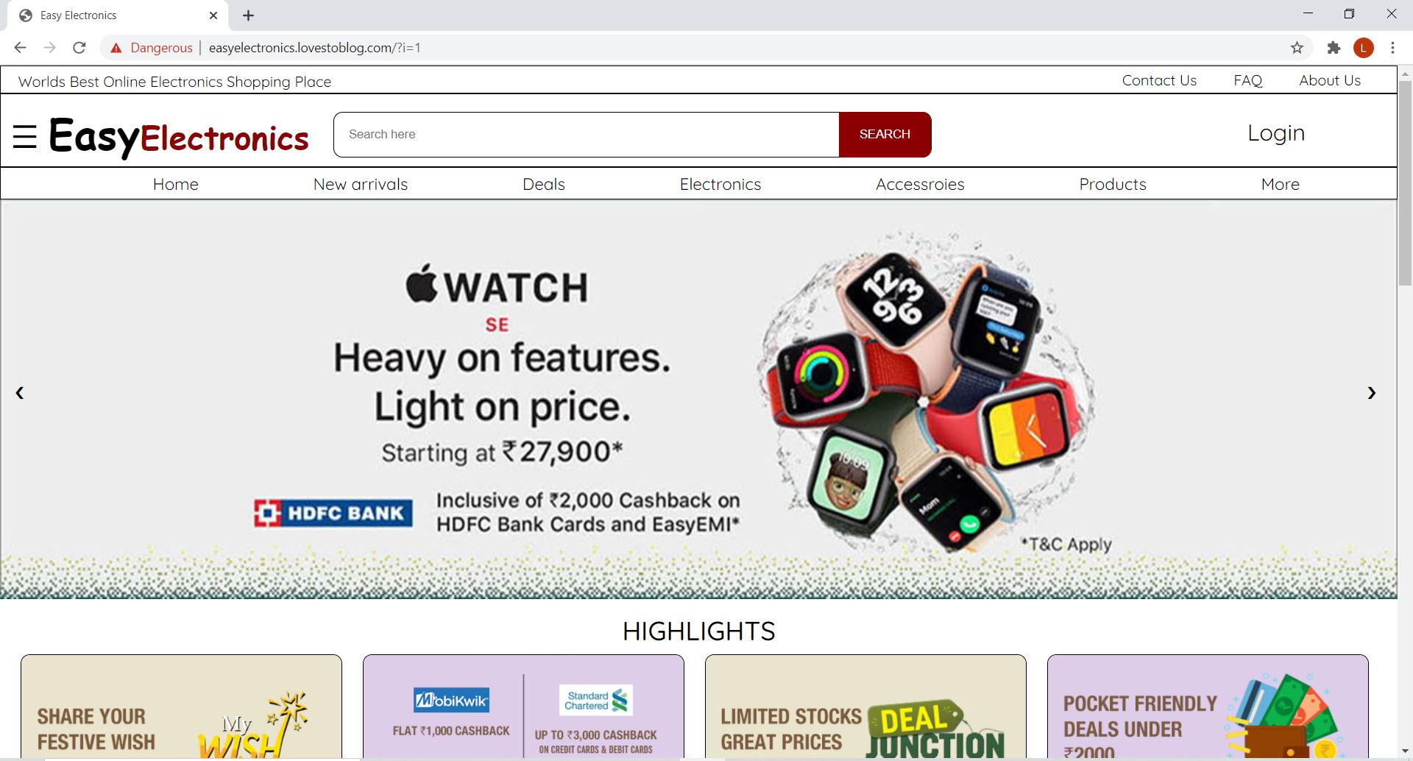
User Interface Design

Slide 10
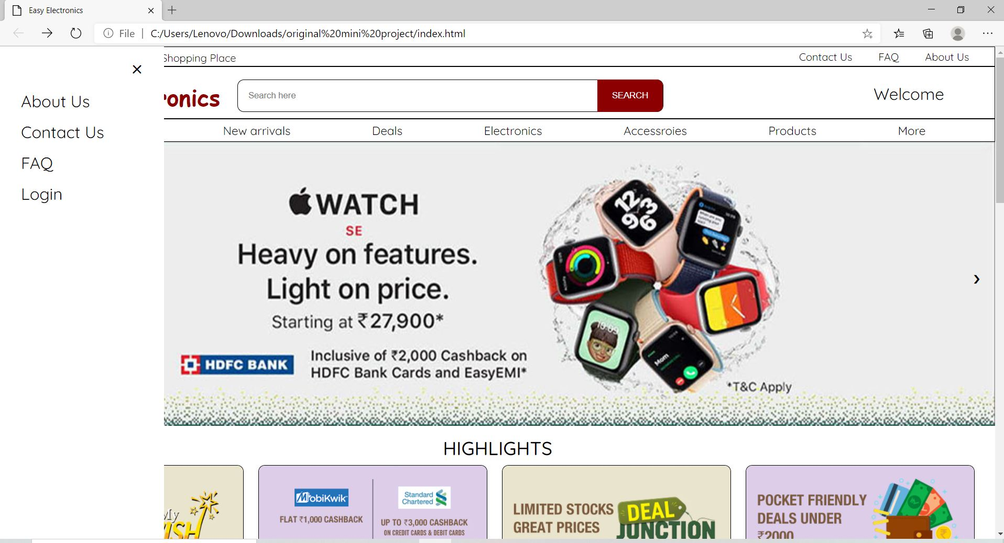
User Interface Design

Slide 11
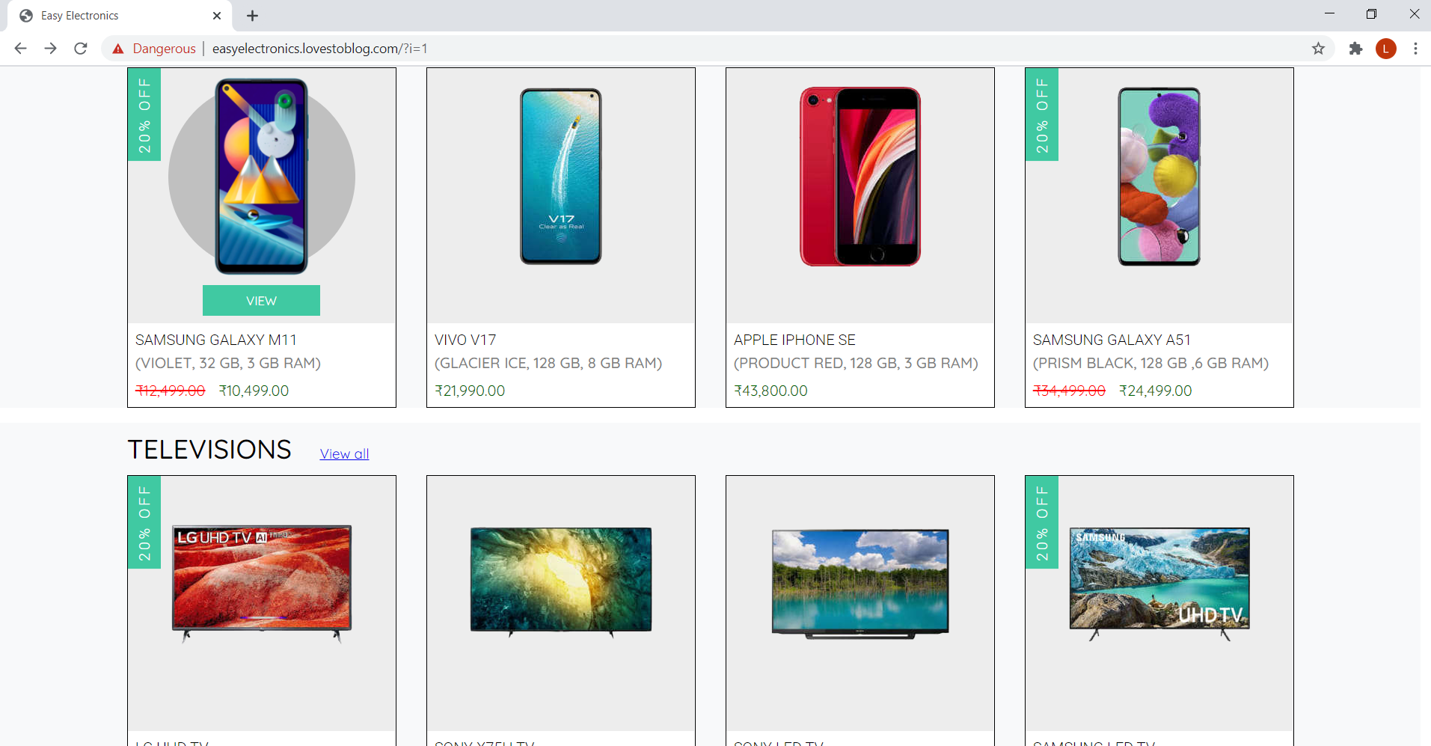
User Interface Design

Slide 12
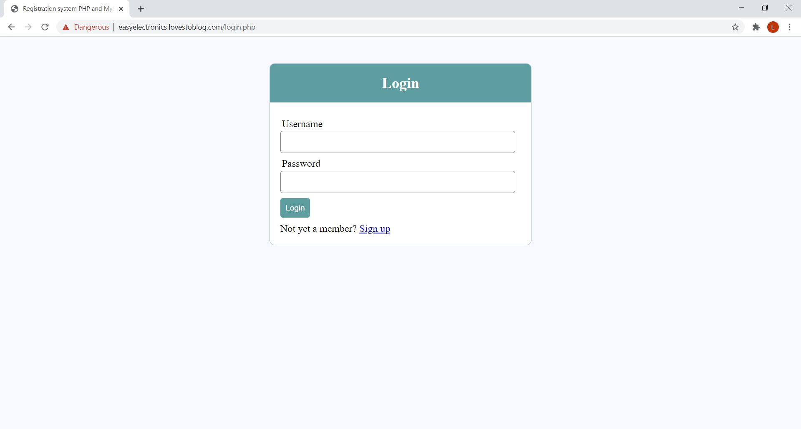
User Interface Design

Slide 13
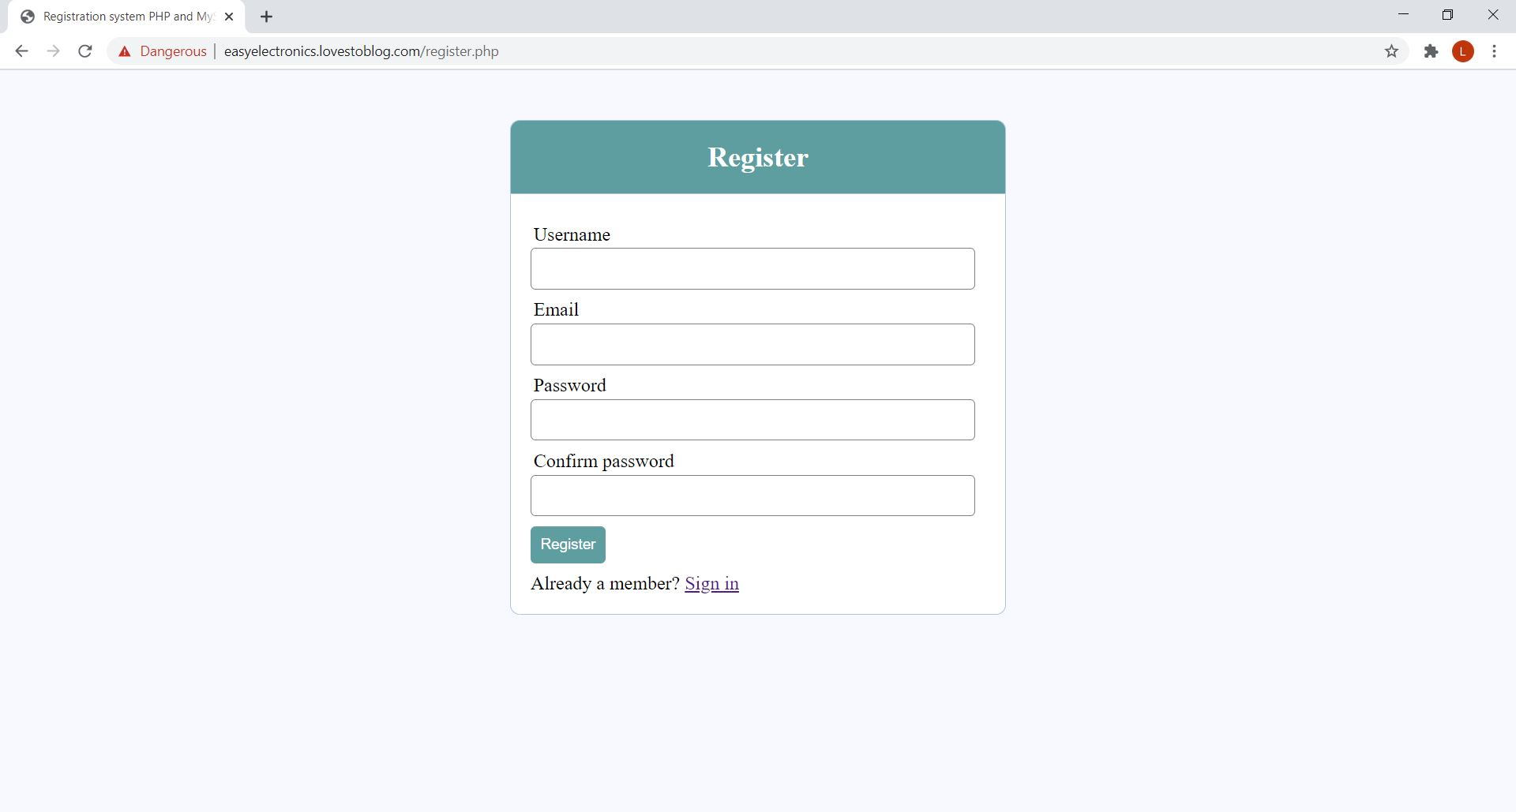
User Interface Design

Slide 14
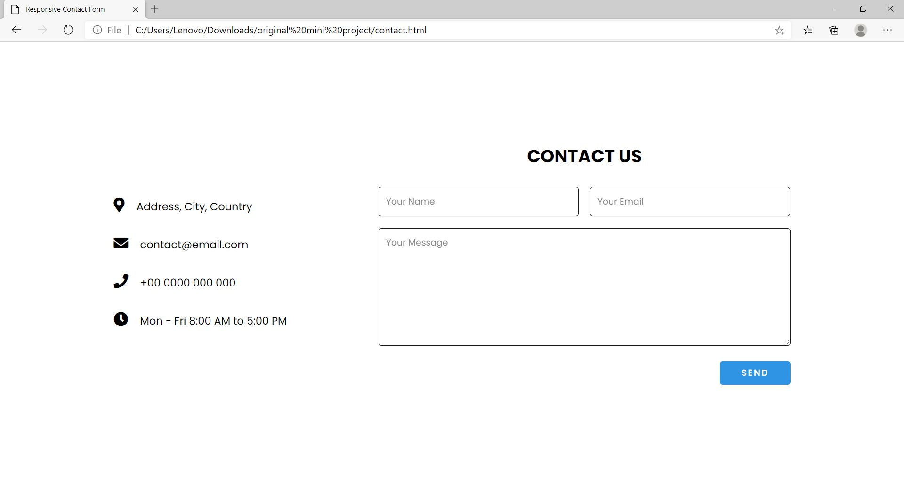
User Interface Design

Slide 15
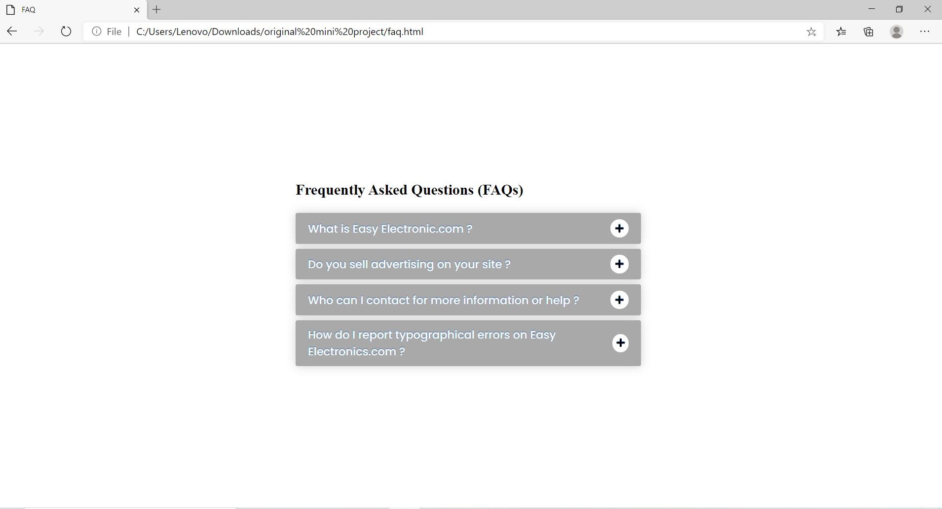
User Interface Design

Slide 16
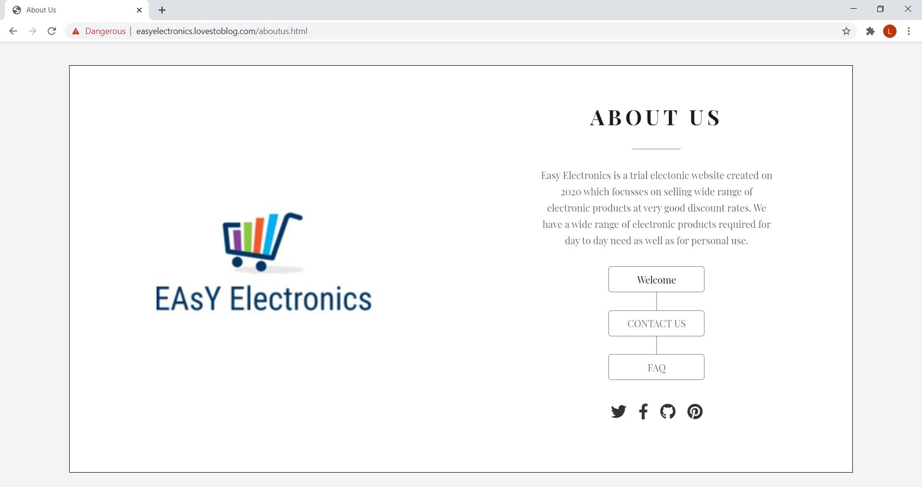
User Interface Design

Slide 17
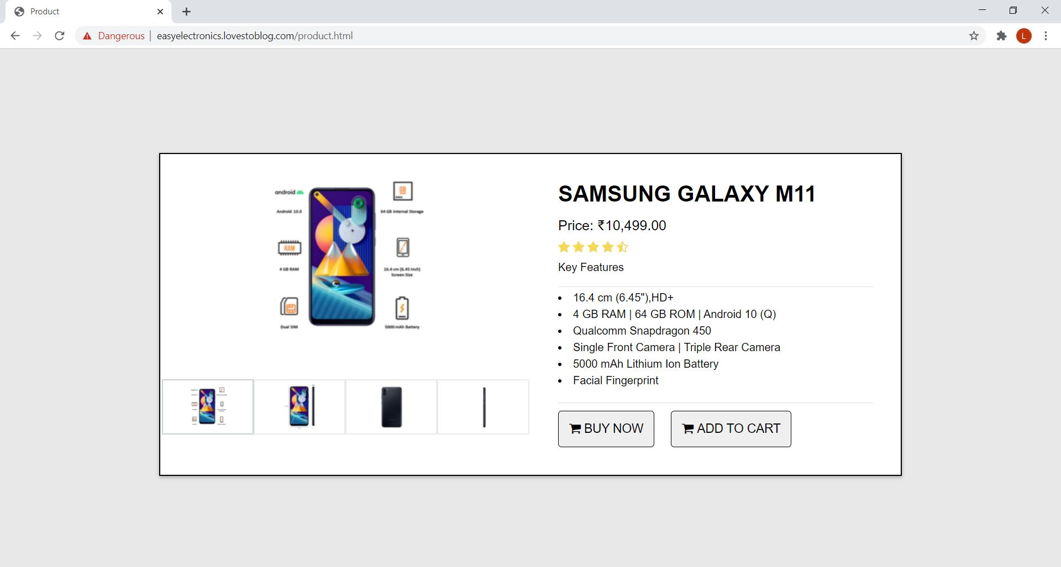
User Interface Design

Slide 18
Results and Discussions
Sr. No. | Technology used | Function/feature/technique | Part of the website
1 | JavaScript | Banner/Products/slider Menu | Home/Products
2 | PHP | Database Connectivity | Registration form/ Login form/Contact Us
3 | HTML5 | Images | Images of products
4 | CSS Animation | Transition,Transformation | Products/Banner
5 | CSS3 | Transition(Hover) | Navigation

Slide 19
Conclusions
This website will provide all types of electronic gadgets that are required for every small thing.
It will enable users to login to the website with the use of the login/registration system that we have created.
On successful login, customers will be able to choose their preferred products from the different varieties of options provided.
We made use of HTML, various CSS styles and JavaScript to create our website. We have incorporated various features like responsive web design, transitions, animation, client side validation embedded multimedia and made use of various colorful fonts to make our website seem interesting while maintaining a minimalistic design for ease of use. The website is user friendly and the user can handle the website easily.

Slide 20
Future Scope
In the future, we plan on enhancing the present features as well as adding some more features like add to cart to improve the performance of the website and make it as user friendly as possible.
We intend to add more products for the customers so that their choice is not limited .
Enable live tracking of products.
To provide personalized recommendations to customers with the use of a unique database.

Slide 21
Literature Cited
Website
Buttons, www.w3schools.com, Available:https://www.w3schools.com/css/css3_buttons.asp
Table w3schools Available: https://www.w3schools.com/html/html_tables.asp
Using css animation,MDN web docs Available:https://developer.mozilla.org/enUS/docs/Web/CSS/CSS_Animations/Using_CSS_animations
Php syntax, w3schools.com, Available:https://www.w3schools.com/php/php_examples.asp
Learn javascript, code academy, Available: https://www.codecademy.com/learn/introduction-to-javascript
The modern javascript tutorial ,javascript.info ,available: https://javascript.info/
Xampp tutorial -installation and first steps ,ionos by 1&1 ,Available: https://www.ionos.com/digitalguide/server/tools/xampp-tutorial-create-your-own-local-test-server/

Slide 22
Questions??
Thank You!

